Slide 1
HR Analytics Dashboard
“A Data-Driven Overview of Workforce Composition and Performance”

Slide 2
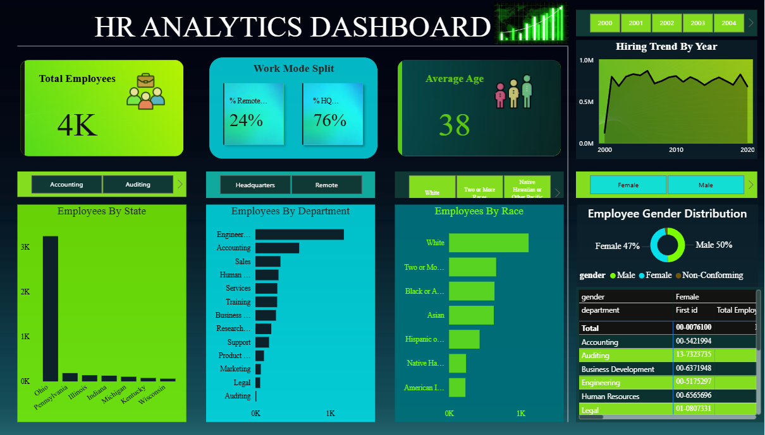
Visual Overview of Key HR Metrics

Slide 3
Key Insights
The organization comprises a total workforce of 4,000 employees.
The average employee age is 38, indicating a mid-career workforce profile.
76% of employees are office-based, while 24% work remotely, suggesting a strong central operations focus.
Hiring has shown consistent growth over the past two decades, highlighting steady organizational expansion.
Ohio has the highest employee concentration, significantly outpacing other states.

Slide 4
Key Insights
The Engineering department holds the largest headcount, reflecting its strategic importance.
Gender representation is balanced, with 50% male, 47% female, and 3% non-conforming employees.
The workforce is diverse, though predominantly White, followed by multiracial and Black or African American groups.

Slide 5
Recommendations
Promote inclusive hiring in male-dominated departments like Engineering.
Evaluate workforce distribution to assess over-reliance on the Ohio region.
Utilize historical hiring trends to forecast and plan future talent acquisition.
Strengthen DEI initiatives to increase representation of underrepresented racial groups.
Launch upskilling programs for aging departments to future-proof capabilities.

